Slide 1
Commercial Data Processing Workflow
20250107

Slide 2
Purpose & Context
Current Commercial Data Processing Workflow
Understanding, Transition Needs, and Automation in Parallel
Purpose
  Restate Kal’s current commercial data process
  Confirm shared understanding of the workflow and assumptions
  Identify what is needed to transition ownership
  Questions

Slide 3
End-to-End Workflow
High-Level Process
  Data receipt via PMI secure transfer
  Download, unpacking, and folder setup
  Manual organization and verification
  MRI handling
  TDC handling
  Treatment tracking
  SQLite (local.db) review
  PEDA execution
  Post-PEDA cleanup
  Upload, vaulting, and notification

Slide 4
Data Preparation (MRI + TDC)
Data Intake & Setup
  Files downloaded from PMI secure email link
  Processed on RDC Toronto CPU
  Script creates folder structure and unpacks ZIPs
MRI Handling
  MRI ZIP unpacked and re-zipped
  No file renaming or modification
  De-identification with spot checks
TDC Handling
  TDC ZIP unpacked and reorganized
  Logs moved to expected locations
  Session folders re-zipped
  Raw folders removed after compression

Slide 5
Review, PEDA, and Closeout
Structured Review
  local.db opened manually
  Patient-related fields checked
  Identifiers removed if present
PEDA Execution
  PEDA run via batch file
  Progress monitored
  Failures noted as needed
  Limited concurrency to manage resources, i.e., not parallelized (trivial parallelization), yet.
Post-PEDA
  Outputs separated (full data vs video)
  Large files stripped from video outputs
  Final artifacts zipped, uploaded, vaulted (sync.com via browser only)
  Standard notification sent

Slide 6
Transition Handoff
From Kal
  Commercial Treatments.ps1
  Commercial Treatment Processing.ps1
  Screen recordings requested: GE / Siemens / Philips (no narration)
Data flow & communication
  How is processed data uploaded (sync.com)?
    Mentioning to Kal
  Who receives processed outputs (incl. Data Science / NAS)?
  What is the standard notification email and distribution list?
  Is a tracker required for runs and exceptions?
Decision authority
  Who decides required vs historical steps?
  Who decides field retention (e.g., birth year)?
    Currently retained with no documented rationale
  For missing data or PHI edge cases, who is the authority?
  Is there a governing SOP?
    If not, is the expectation that I draft it?
    Driver
Risk & accountability
  How are decisions documented and defended (audit trail)?
    Script to identify and de-identify
Access & transition
  Defined scope and access to the processing environment
    Who has preemptive access if the environment is in use?
  Concrete handoff point/date

Slide 7
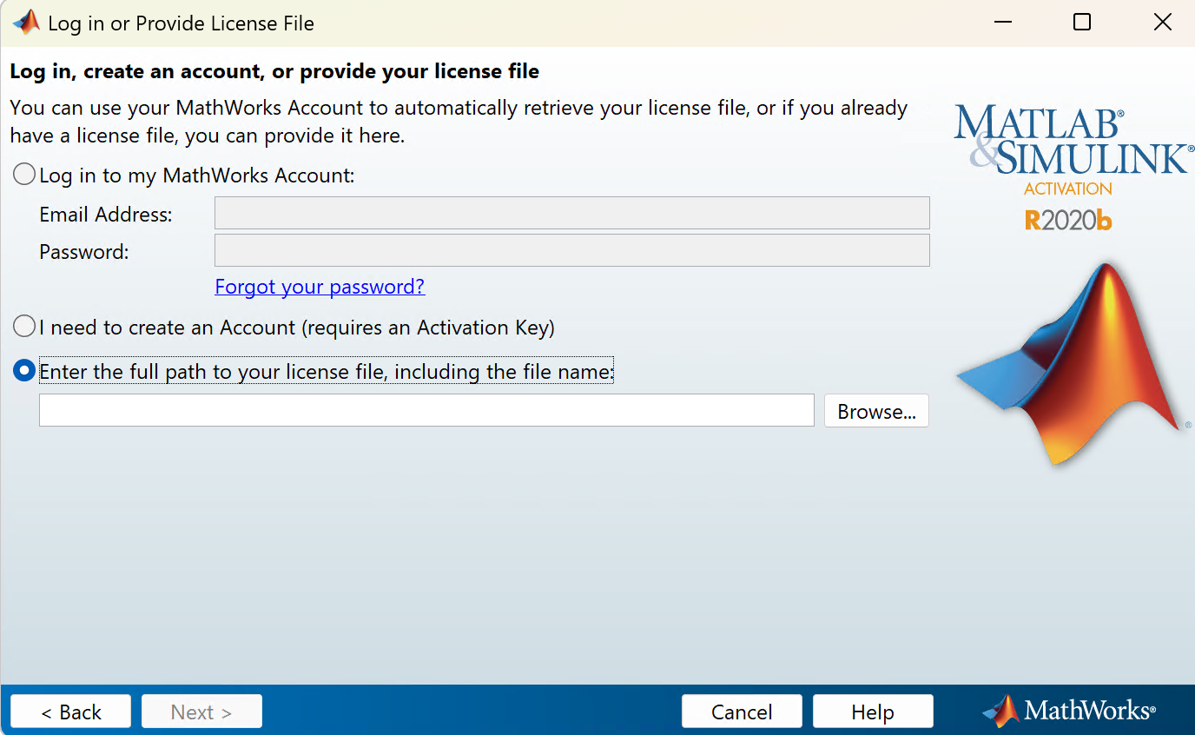
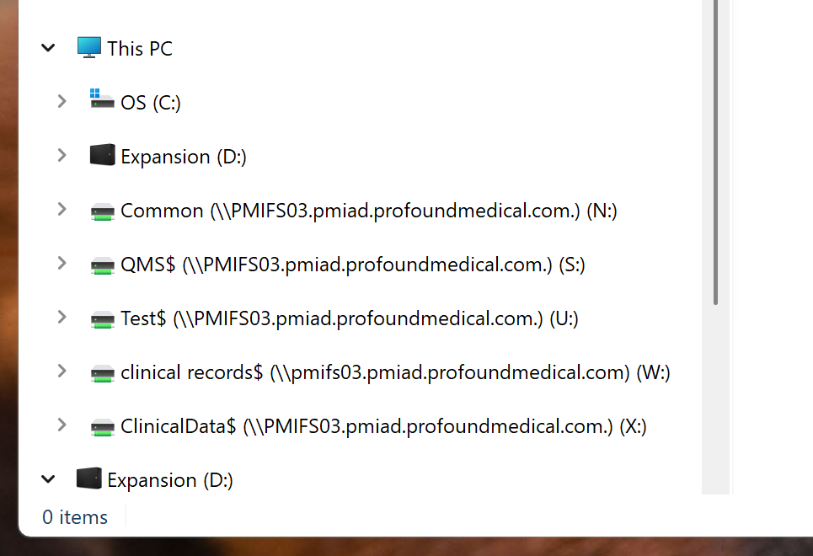
Ask Kal
Where does Kal store the processed data, or where would he prefer?
Which license, where?

Slide 8
What is Needed to Take This Over
Transition
  Need
    Scripts from Kal
      Commercial Treatments.ps1
      Commercial Treatment Processing.ps1
    How to upload to sync.com?
    Who needs information regarding the processed data?
      Data Scientist NAS device for review
    Something about a tracker?
    Standard email goes to what parties?
      From last one I did, cc’d
        Abhilash Nair <ANair@profoundmedical.com>; Alexander Dunn <ADunn@profoundmedical.com>; Ben Leung <bleung@profoundmedical.com>; Brandon Coles <BColes@profoundmedical.com>; Christian Sprang <CSprang@profoundmedical.com>; Jonathan Lee <JLee@profoundmedical.com>; Josh Blazina <JBlazina@profoundmedical.com>; Norm Morikawa <NMorikawa@profoundmedical.com>
  Questions
    Who decides whether a step is required versus historical?
    Who decides whether specific fields (e.g., birth year) are preserved or removed?
      Currently the birth year is retained but it is not clear why and Kal was never given a reason
    For questions beyond code execution—such as missing data handling or PHI edge cases—who is the authoritative point of contact?
    What is the governing SOP for these decisions and this process?
      Does one exist today?
      If not, is the expectation that I draft it? (I’m comfortable doing so.)
    When judgment calls are required, who absorbs the risk?
    How are decisions documented and defended later, e.g., during audits or reviews?
  Defined scope and expectations
  Access to processing environment
    How is access allotted? If I can’t get on the computer if someone else is on, who has preemptive power.
  A concrete transition plan with a handoff point
    I would like Kal to video record his screen for a GE, Siemens, and Philips case
    No need to narrate, just screen record and I’ll dig through it

Slide 9
Automation in Parallel
Parallel Automation Strategy
  Replicate current assumptions first
  Validate automated outputs against existing results
  Run side-by-side until equivalence is confirmed
  Make changes incrementally
  Preserve current endpoints throughout
Goal
Reduce manual risk over time without disrupting a working process
  Risk-> typos, PHI, data loss, auditability, etc.

Slide 10
Purpose of This Walkthrough
Restate current commercial data processing workflow as implemented today
Confirm shared understanding of the process and assumptions
Identify what is needed to transition ownership
Clarify how automation will proceed in parallel without disrupting output

Slide 11
High-Level Workflow Overview
Data receipt (secure transfer)
Initial download and folder setup
Manual organization and verification
MRI handling
TDC handling
Treatment tracking
SQLite (local.db) review
PEDA execution
Post-PEDA cleanup
Upload, vaulting, and notification
Single-operator, serial process optimized for correctness and consistency

Slide 12
Data Receipt & Setup
Data Intake
Files received via PMI secure transfer
Downloaded from email link
Processing performed on a dedicated high-resource machine via remote desktop
Initial Setup
Files downloaded to local Downloads
Script:
  prompts for site and treatment
  creates folder structure
  copies ZIPs
  unzips contents
Original ZIPs deleted after extraction

Slide 13
Manual Organization & MRI Handling
Manual Organization
Data moved into standard folders:
  MRI
  TDC
  Treatment report
Treatment PDF opened to confirm no PHI, then closed
MRI Handling
  MRI ZIP unpacked
  ZIP deleted after extraction
  No renaming or modification unless required
  Relies on site-level de-identification
  Spot checks performed as needed

Slide 14
TDC Handling & Tracking
TDC Handling
  TDC ZIP unpacked and deleted
  Folders renamed or reorganized for consistency
  Log folders moved to expected locations
  Session folders re-zipped
  Raw folders deleted after compression
Treatment Tracking
  Tracker updated manually:
    site ID
    treatment number
    upload date
    study designation
  Treatment marked “in processing”

Slide 15
SQLite Review & PEDA Execution
SQLite (local.db) Review
  Database opened manually
  Patient-related fields checked
  Any identifiers removed if present
  Database closed after verification
Running PEDA
  PEDA launched via batch file (“Run PEDA”)
  No direct MATLAB interaction
  Progress monitored intermittently
  Failures retried as needed
  Concurrency kept low to manage resources

Slide 16
Post-PEDA & Closeout
Post-PEDA Cleanup
  DICOM data zipped, raw folders removed
  PEDA outputs separated:
    full data
    video-only outputs
  .mat files stripped from video outputs
  Final artifacts zipped
Upload & Notification
  All ZIPs uploaded to Sync
  Data moved to vault locations
  Standard notification email sent
  Treatment marked complete
  TDC logs copied to Data Scientist NAS

Slide 17
Key Characteristics of the Current Process
What Makes This Work Today
  Single accountable operator
  Well-established assumptions
  Manual verification where needed
  Outcome-focused, not tool-focused
  Optimized for correctness over scale

Slide 18
What I’d Need to Take This Over
To Transition Ownership Successfully
  Clear ownership and decision authority
  Defined scope of responsibility
  Access to equivalent processing environment
  Agreement on required vs historical steps
  Clarity on PEDA expectations and support
  A concrete transition plan

Slide 19
Automation in Parallel
Automation Approach
  Replicate existing assumptions first
  Validate automated outputs against current results
  Run side-by-side until equivalence is clear
  Make changes incrementally
  Preserve current endpoints throughout
  Automation as risk reduction, not behavior change

Slide 20
Summary
Current process is well-understood and reliable
Transition requires clarity, not reinvention
Automation can proceed safely in parallel
Goal is continuity, stability, and gradual improvement

